Slide 1


BUILD YOUR PERSONAL AI AGENT WITH CLAUDE CODE & COWORK

Slide 2



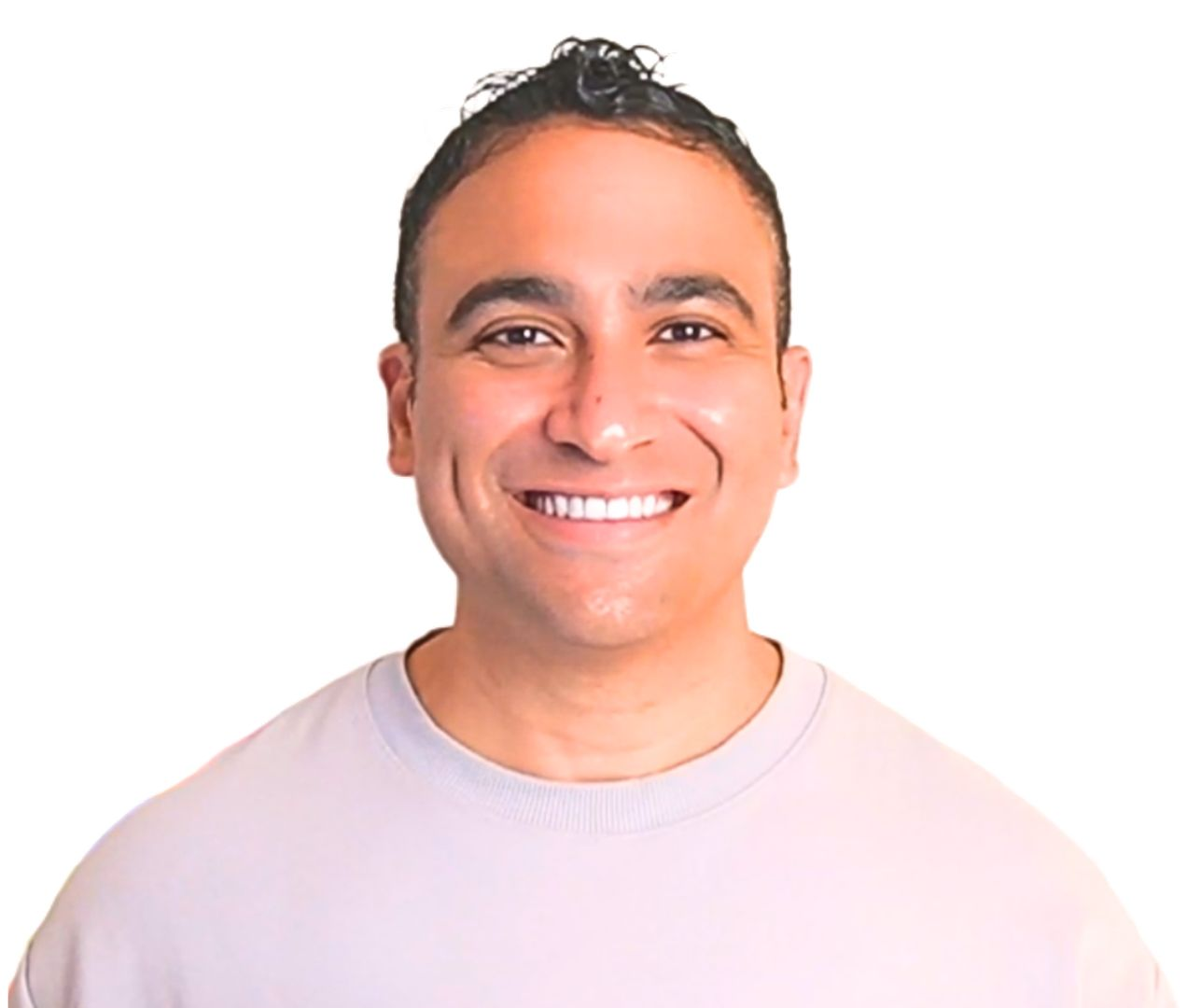



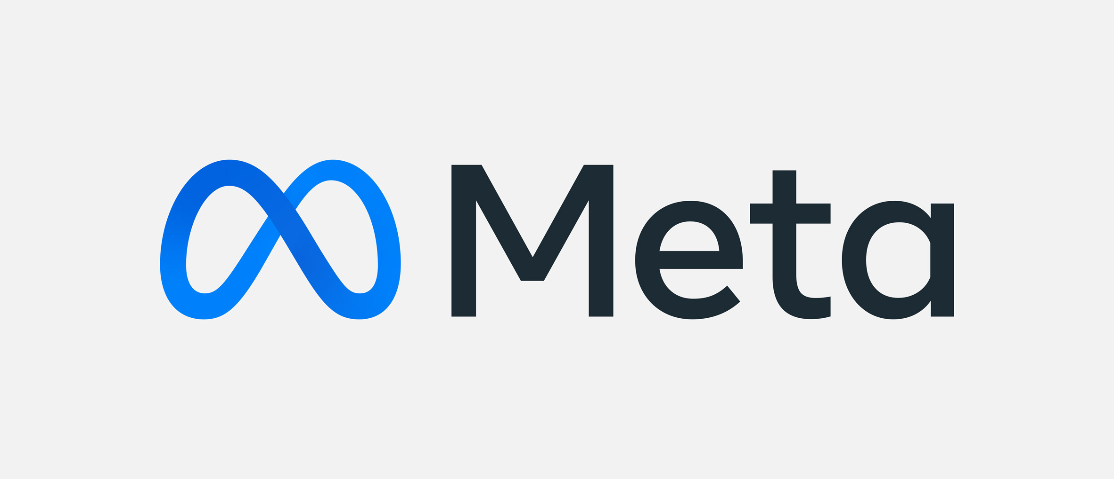





Instructor Introduction
580,000 Students
M.A.Sc., Ph.D., MBA
260,000+ Subs, 4M views
© All rights reserved for Dr. Ryan Ahmed @Stemplicity Inc.
Dr. Ryan Ahmed Professor & Best-selling Instructor
AI & EV/AV

Slide 3
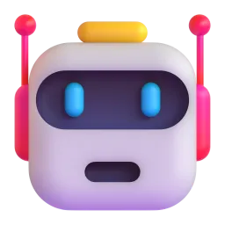
It's 7:47 AM. I pick up my phone and say: ‘Hey Jarvis, what do I need to know today?
My personal AI agent replies: “3 urgent emails, a board meeting at 2 PM, and a competitor just raised $40M. Here's your morning brief. Here's the deck for your 2 PM.“
© All rights reserved for Dr. Ryan Ahmed @Stemplicity Inc.

Slide 4
AI Can Now Work a Full Shift
What This Means:
2019
~1 min
A single function
2023
~15 min
A small coding task
Task Completion Time Horizon (minutes)
© All rights reserved for Dr. Ryan Ahmed @Stemplicity Inc.
2024
~21 min
A short assignment
2025
~2 hrs
A serious work block
2026
~12 hrs
A full work shift
Source: https://metr.org/blog/2025-03-19-measuring-ai-ability-to-complete-long-tasks/

Slide 5
If AI is that capable, what if you design a personal AI agent that actually knew you? Your goals, business, and your brand.
How you write. What "urgent" means to you. How you make decisions. Today, you can build a personal Agent with Claude Code & Cowork.
© All rights reserved for Dr. Ryan Ahmed @Stemplicity Inc.

Slide 6
Work Is Being Rewritten by Personal AI Agents
“We’re moving from doing work manually to AI-assisting tasks to personal agents executing entire workflows.”
2024
2025
2026
Manual Era
AI-Assisted Era
Personal AI Agents Era
© All rights reserved for Dr. Ryan Ahmed @Stemplicity Inc.
Days
per deliverable
Hours
per deliverable
Minutes
per deliverable
→
→
You do everything yourself
emails, meetings, scheduling, docs
You use AI tools
Copilot, ChatGPT
You delegate to personal AI agents
built and orchestrated in Claude Code
AI helps with tasks
meeting summaries, email drafts, scheduling help
Work is fragmented
switching between tools, manual follow-ups
Agents execute workflows
emails, organized calendars, decision-ready summaries

Slide 7



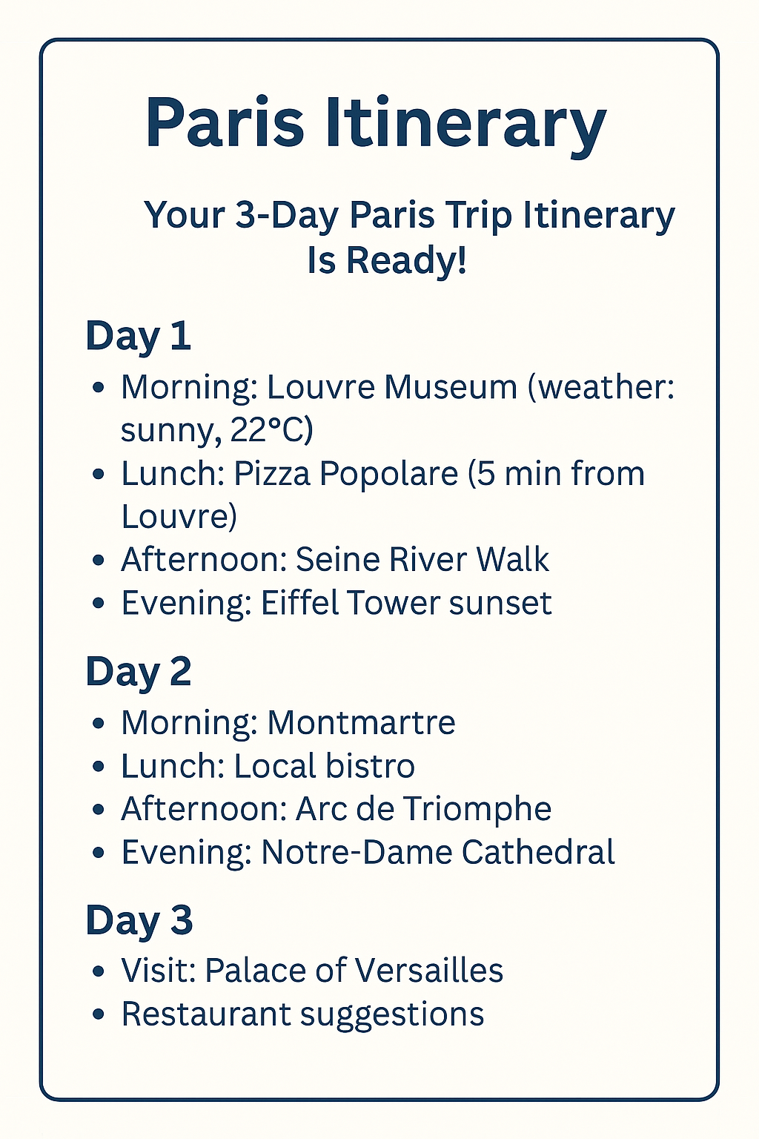




AI Agents 101
AI agents are intelligent systems that take a goal, plan the steps, and autonomously execute them using tools & knowledge with minimal human input.
Planning: schedule sightseeing, check weather
Memory: recalls that user likes museums
Tools: maps, hotel, weather
AI Agent
“Plan my 3-day trip to Paris”
© All rights reserved for Dr. Ryan Ahmed @Stemplicity Inc.
Large Language Model
Planning
Tools
Memory

Slide 8
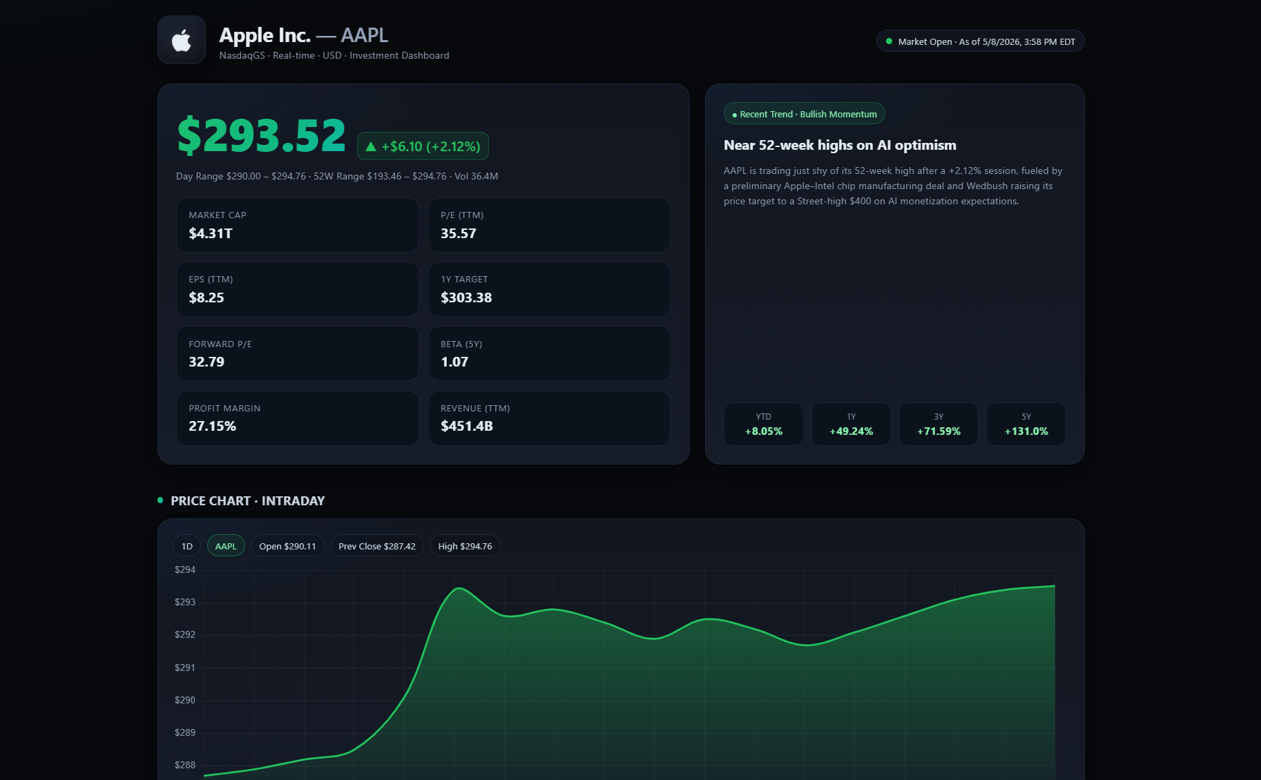
AI Agents in Action
Claude Agent in Chrome
© All rights reserved for Dr. Ryan Ahmed @Stemplicity Inc.

Slide 9
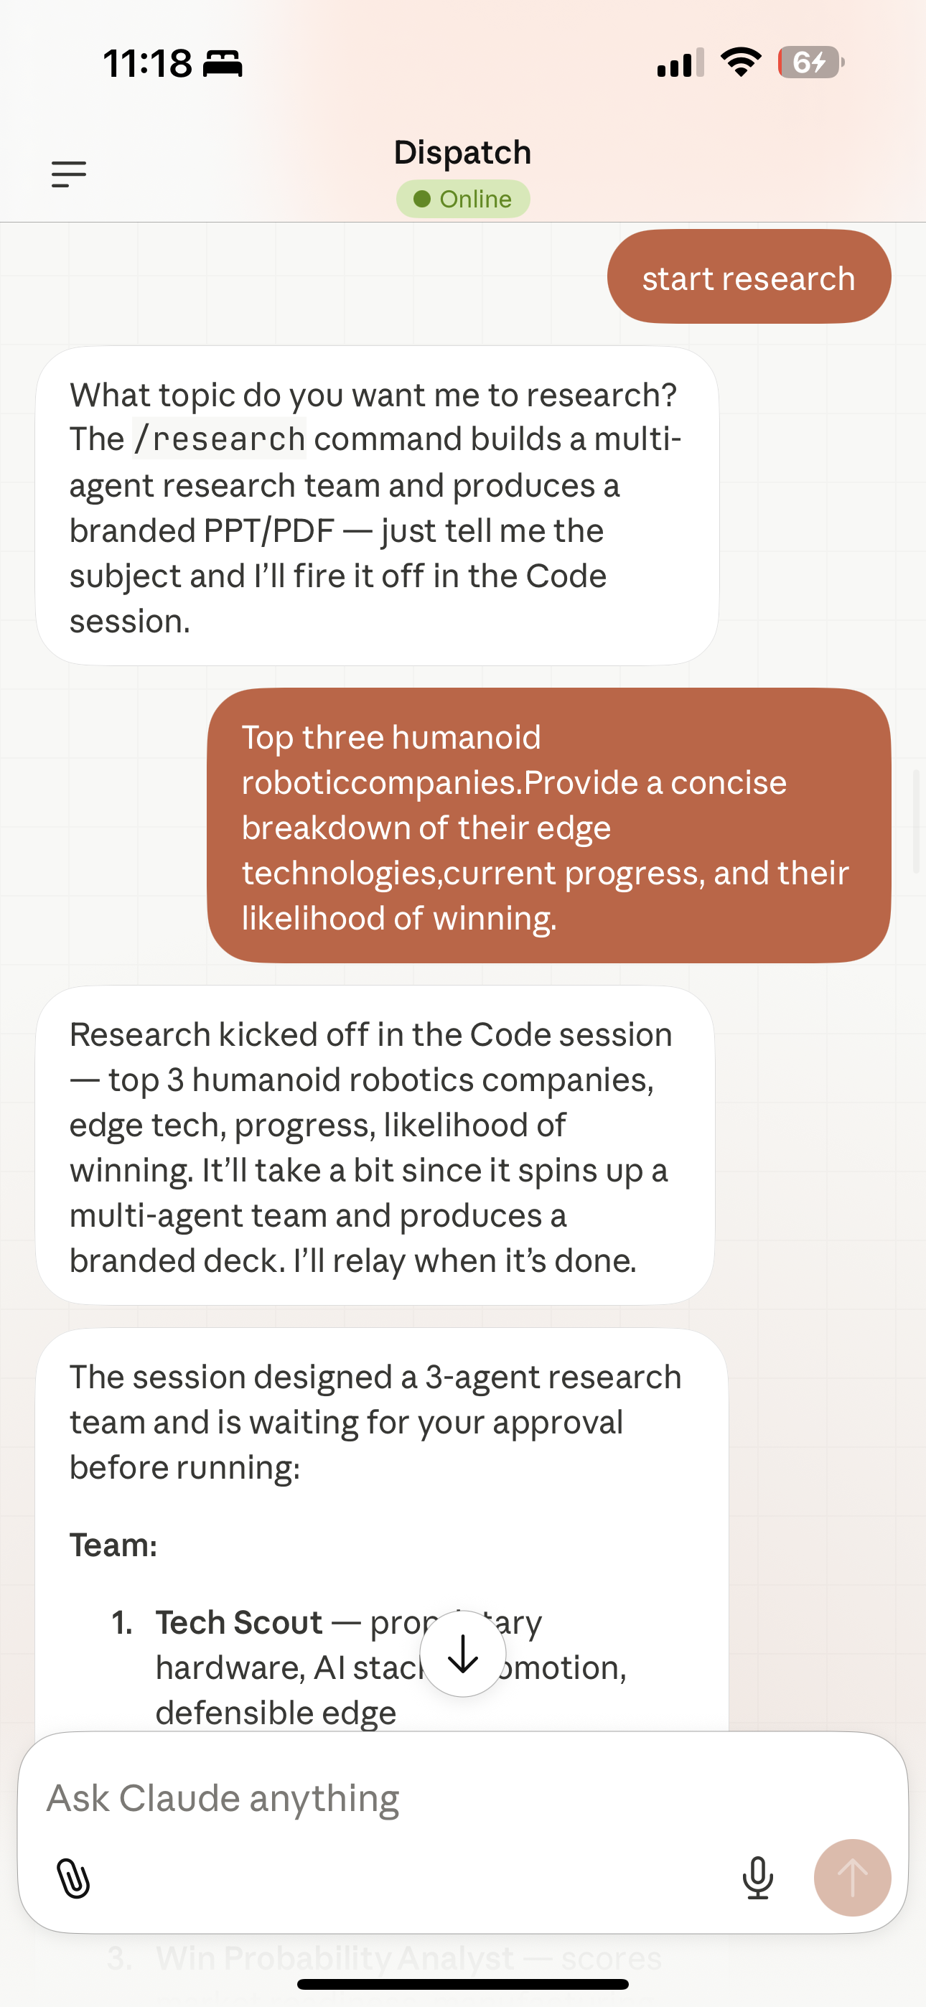
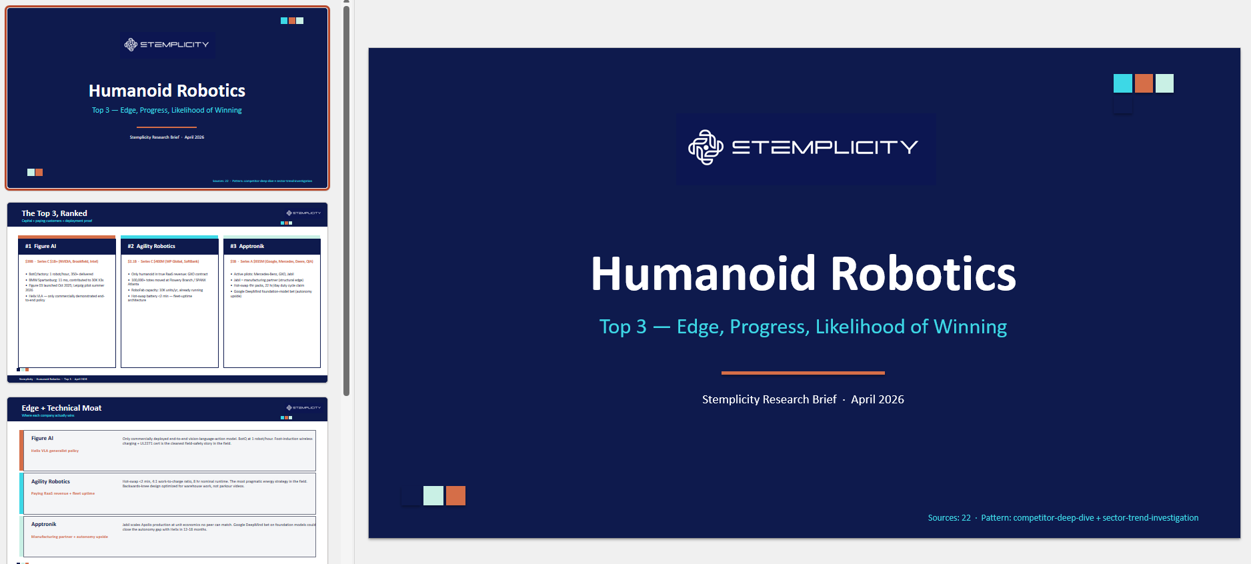
What you’ll build today!
© All rights reserved for Dr. Ryan Ahmed @Stemplicity Inc.

Slide 10
MASTERCLASS OUTLINE & LEARNING OBJECTIVES

Slide 11
Key Learning Objectives
Build and deploy a personal AI agent using Claude Code + Cowork
Design a persistent agent identity (“Soul.md”) aligned with your workflow and style
Orchestrate multi-agent teams to research, write, and review in parallel
Connect real-world tools (email, calendar, Notion) via MCP integrations
Implement ready-to-run automation blueprints for daily workflows
Create custom skills, plugins, and slash commands for repeatable tasks
Enable autonomous execution with scheduling, triggers, and approval flows
Set up persistent memory (e.g., Obsidian) so agents improve over time
Operate and control agents from your phone (Dispatch) for real-time delegation
© All rights reserved for Dr. Ryan Ahmed @Stemplicity Inc.

Slide 12
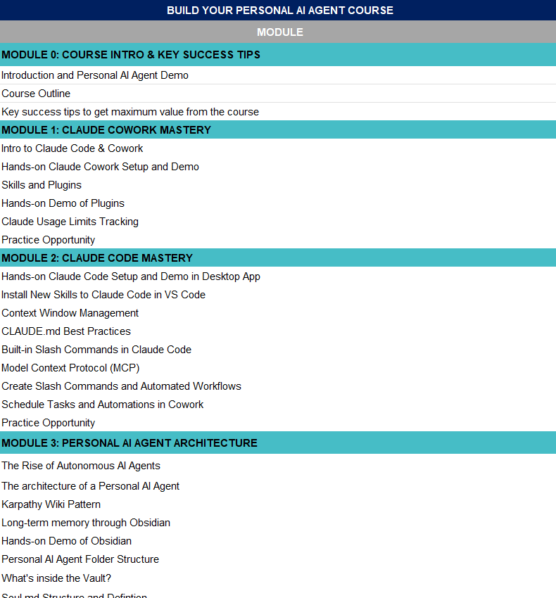
Workshop Outline
Open this Excel sheet in the workshop package titled: “Personal AI Agent Workshop - Outline.xlsx”
© All rights reserved for Dr. Ryan Ahmed @Stemplicity Inc.

Slide 13
SUCCESS TIPS

Slide 14
Success Tips
Build Live (Hands-On)
Don’t just watch, build alongside.
Complete at least 1 working agent + 1 automation by the end of the masterclass.
Focused Deep Work (No Multitasking)
No multitasking. Deep work only.
Share & Demo
Post your builds. Demo in Q&A. Momentum compounds socially.
Ask Questions in Real Time
Drop your errors.
Share your blockers. Debugging in public accelerates mastery.
© All rights reserved for Dr. Ryan Ahmed @Stemplicity Inc.
LinkedIn Link: https://www.linkedin.com/in/dr-ryan-ahmed/

Slide 15
Thank you!

